Slide 1


MACHINE LEARNING PROJECT
PRESENTED BY:
RADHA GUPTA (21MMA024)
JOYONTO KUNDU (21MMA006)
MANISH SINGH (21MMA014)

Slide 2
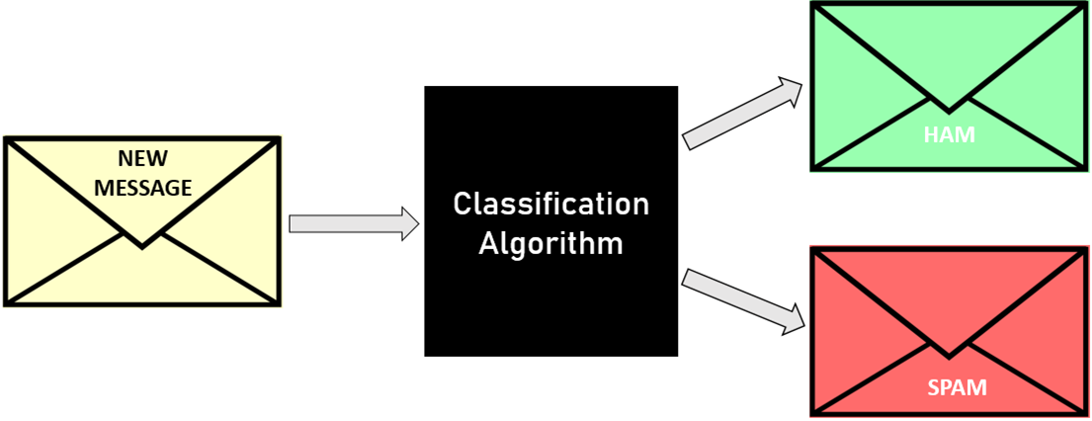
EMAIL SPAM DETECTION

Slide 3
INTRODUCTION
A Spam Detection is a process that is used to detect unwanted email and use to prevent those messages from getting to the user’s inbox.
The main objective of the project is to classify messages into ham and spam.
Different techniques of Supervised Machine Learning are used to reach to the desired goal of the project.
Along with classification, comparison between the techniques is used to find out which one is the best for email spam detection.

Slide 4
OBJECTIVE
In the proposed project we will be using supervised learning techniques for Spam Email Detection.
It analysis the content and find patterns which are used to identify Spam and Ham emails.
Content based methods analyze the content of the email to determine if they are spam or not.
The goal of our project is to analyze Machine Learning algorithms and determine their effectiveness as content-based spam filters.

Slide 5
CONCEPTS USED
NAÏVE BAYES
RANDOM FOREST
SUPPORT VECTOR MACHINE
LOGISTIC REGRESSION

Slide 6
LIBRARIES USED
SEABORN
MATPLOTLIB
PANDAS
WORDCLOUD
PPRINT
SCI-KIT LEARN
NUMPY
TKINTER

Slide 7
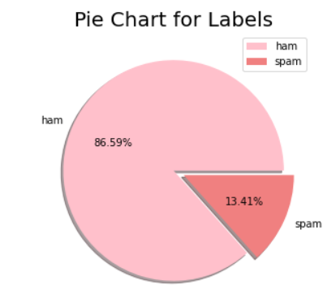

Slide 8
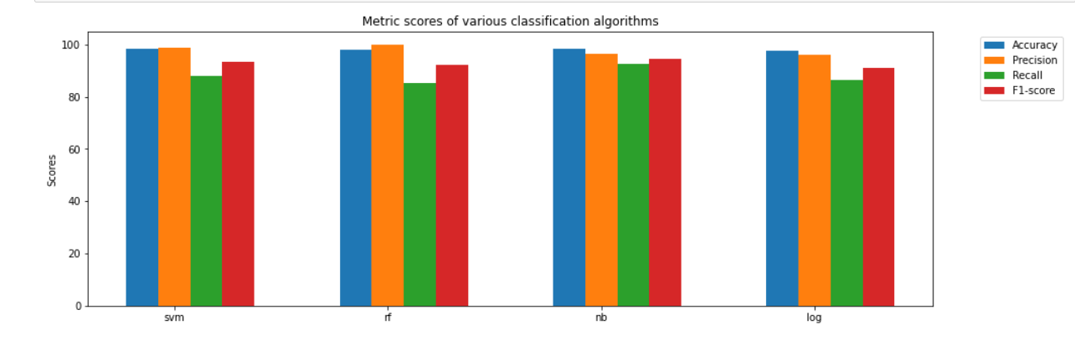

Slide 9
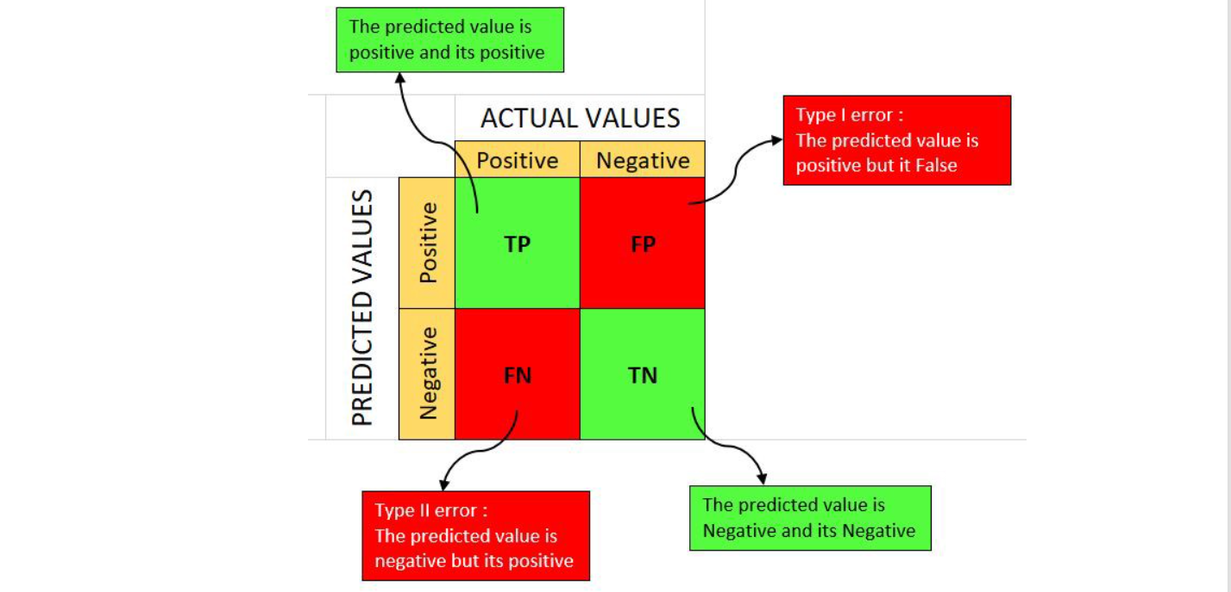

Slide 10
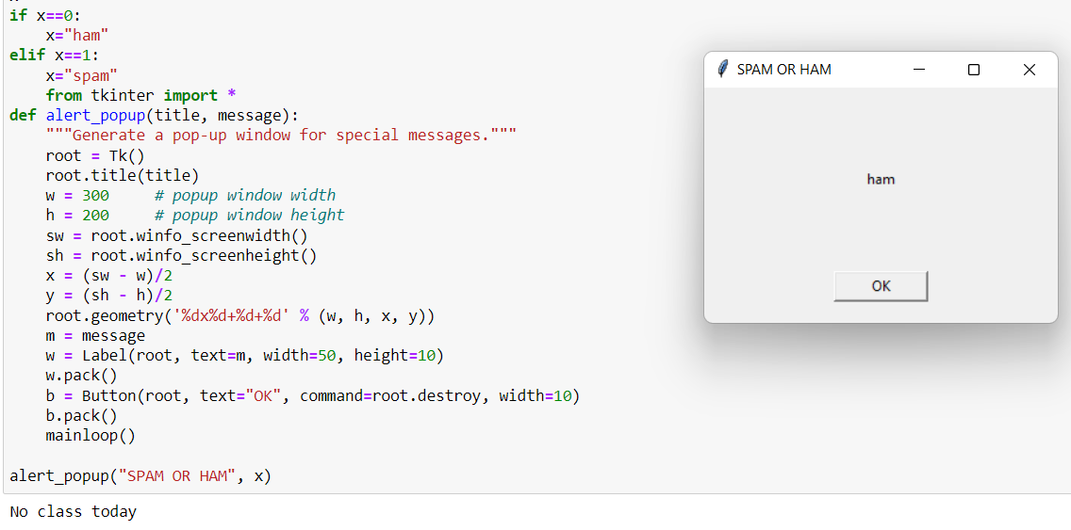

Slide 11
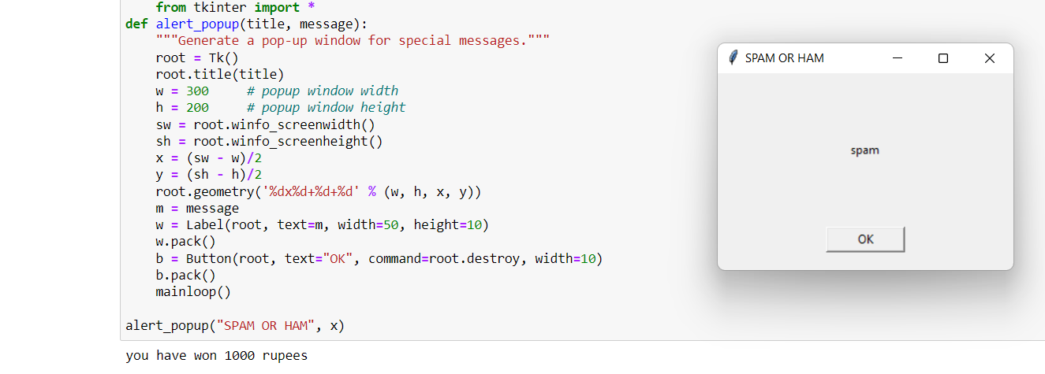

Slide 12
CONCLUSION AND FUTURE SCOPE
It provides sensitivity to the client and adapts well to the future spam techniques.
It considers a complete message instead of single words with respect to its organization.
It increases Security and Control.

Slide 13
ACKNOWLEDGEMENT
We would like to thank our teacher, Dr. Nidhi Gupta who gave us this opportunity to work on this project. We got to learn a lot from this project about various concepts of Machine Learning tools and techniques.
During the making of project we consulted following books:
1. Machine Learning by Tom M. Mitchell
2. Pattern Classification by Richard O. Duda

Slide 14
THANK YOU

